Slide 1
Competency 2 Lesson 2.1.2
Instrument Panel
(DASHBOARD)

Slide 2
TERMINOLOGY:
Gauge: Dial device used to measure the pressure contained in a closed space.
Pressure gauge : Gauge used to measure compressed air present in various circuits of a pneumatic braking system.
Tachometer : Gauge used to monitor engine speed. Revolution per minute (RPM).
Depressure gauge : Gauge used to measure depression in a closed space. Used to measure the clogging level of an air filter. Other term : Vacuum gauge
Mechanical obstructing gauge : Instrument mounted on the housing of an air filter, having a colored membrane, which has a glass indicator to gauge the clogging of the air filter.
Warning light : Indicator light that comes on when the temperature rises, or for example, when the oil pressure drops Other term : Alert indicator
Warning buzzer : Audible device which alerts the driver when the temperature rises, or for example, when the oil pressure drops.
Low pressure gauge : Indicator light that comes on in the event of an abnormal drop in compressed air pressure.
Low pressure warning buzzer : Audible device which alerts the driver when an abnormal drop in compressed air pressure.
The instrument panel (dashboard)l is much more than a display of random gauges, it is the main key to proactive management while driving a heavy vehicle. But, to do this, the driver must be able to interpret and manage the different gauges with ease.

Slide 3
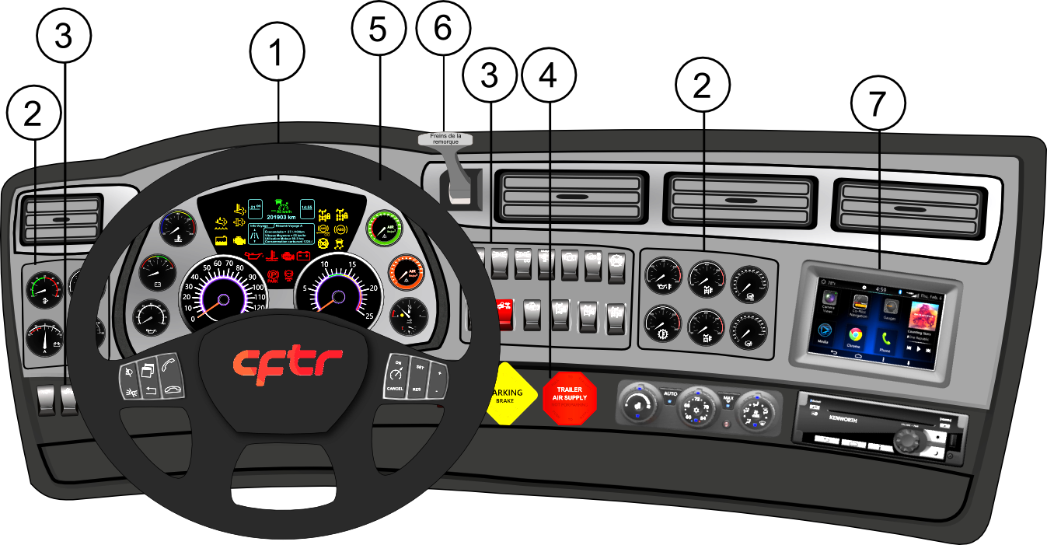

Slide 4
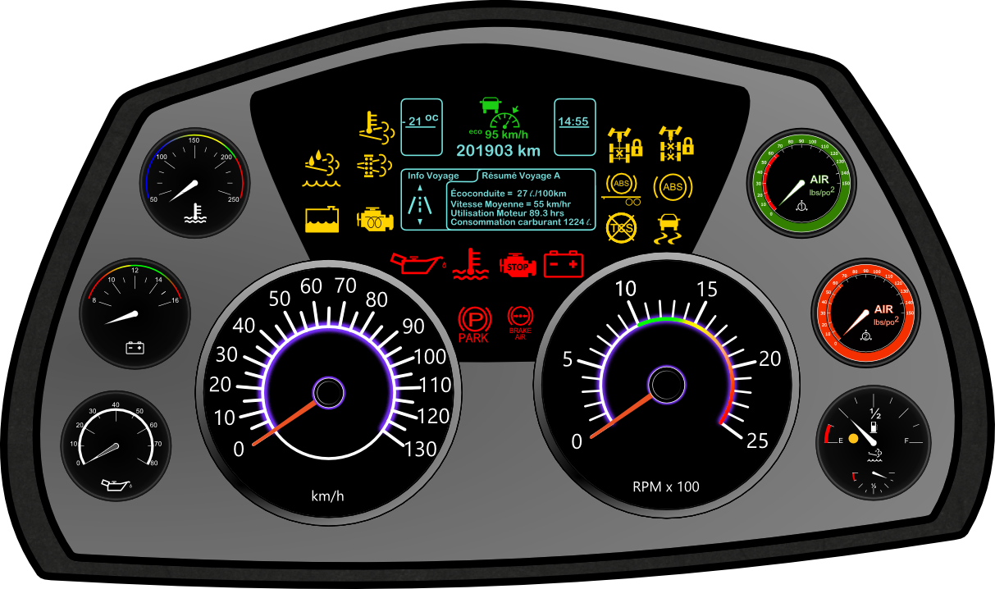

Warning indicators
Indicators of systems in operation
Coolant temperature gauge
Low pressur warning
Voltmeter
Air pressure gauges
Engine oil
Fuel gauge and Diesel Exhaust Fluid (DEF) gauge
Tachometer
Notes:
Définitions à la page 2
L’indicateur de basse pression d’air peut aussi être localisé avec les témoins lumineux
Les témoins d’anomalies jaunes indiquent une anomalie mais qu’il peut continuer à rouler, les rouges indiquent au conducteur qu’il devrait s’immobiliser dans les plus brefs délais.
Les témoins de différents systèmes illustrés sont : interponts, interroues, ABS et antipatinage

Slide 5
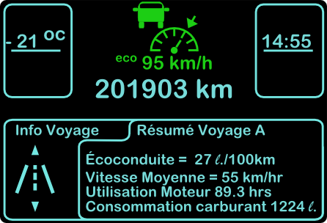
1. Multifunctional Display
Notes:
L’afficheur multifonction indique au conducteur certaines informations: la température, l’ajustement du régulateur de vitesse, le kilométrage, l’heure ainsi que certaines informations du voyage.
Les modèles et les informations peuvent varier d’un fabricant à un autre.

Slide 6
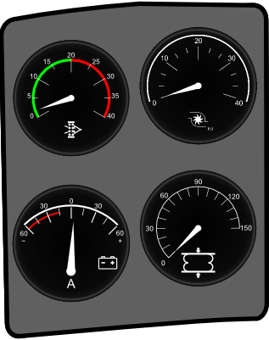
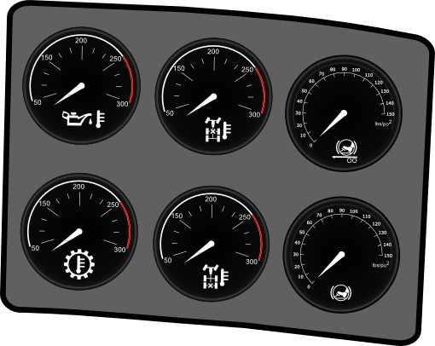
2- The left and right side optional gauges
Vacuum Gauge
Depressure Gauges
Voltage Gauge
Different temperature and pressure gauges
Notes:
La pressions dans les ballons de suspension,et la pression (PSI) d’entrée d’air ”turbo boost”.
Les températures sont en degrés F sur la plupart des camions.

Slide 7
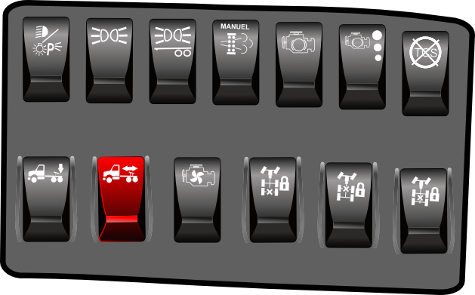

3- Switches
Notes:
List of different pictograms.

Slide 8


4- Yellow button: Tractor Parking brake
Red button: Trailer Air Supply
Pull to apply
Pull to evacuate air
Push to release
Push to supply air
Notes:
Have the students realize that pulling the yellow button both brakes are applied at the same time.

Slide 9

Multifunctional Switches
5. These switches will vary by brand and model
Notes:
Pictograms are very important in order to recognize the use of buttons

Slide 10
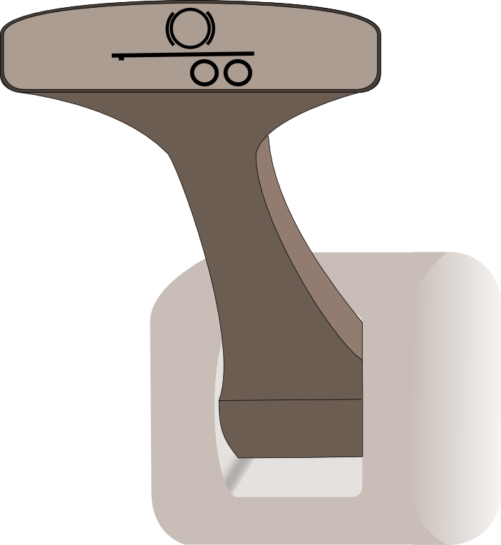
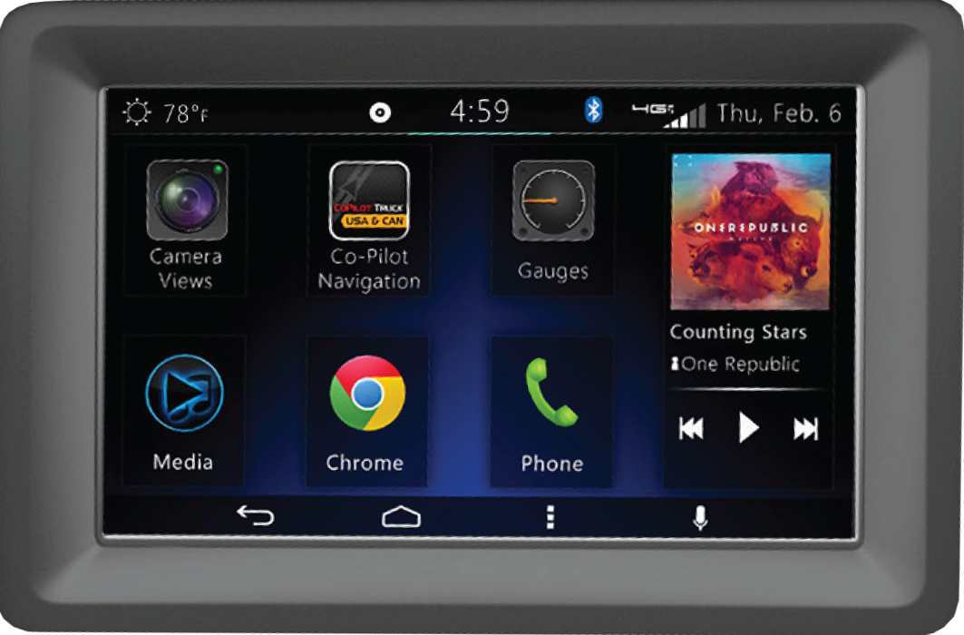
6- Trailer Service Brake (Bendix)
7- Multifunctional Display
Notes:
6. To be used during the Circle Check
7. The content and location of multifunction displays vary by brand, model and option.

